Slide 1
Psychological Mental Health Analyzer CLASSIFICATION USING MACHINE LEARNING
Group Members:
Hritik Negi(2018384)
Rishabh Nautiyal(2018631)
Saksham Bijalwan(2018684)
Anjali(2018439)
Guided By:
Miss. Manika Manwal

Slide 2
ABSTRACT
Domain: Real-time psychological analysis using pre-stored information and advanced Natural Language Processing (NLP) techniques.
Objective: Enhance precision and accuracy of psychological evaluations by analyzing language patterns in live conversations.
Target Audience: University students, working professionals, and introverted individuals.
Focus: Stress prediction and identification of stress and depression.
Approach: Leveraging NLP and machine learning techniques to detect subtle linguistic cues indicating psychological distress.
Methodology: Comprehensive comparative analysis of various methods for discerning depressive states from textual data.
Contribution: Advancement in understanding live text patterns and implications for mental health, with significant implications for personalized mental health interventions.

Slide 3
EXISTING SYSTEM
Existing systems for psychological mental health analyzer classification using machine learning encompass a range of methodologies and approaches tailored to different data modalities and classification goals.
These systems leverage ML algorithms to analyze various types of data like text.

Slide 4
SYSTEM REQUIREMENTS
HARDWARE
SOFTWARE
System: Ryzen 5/Intel i5 or i7.
Hard Disk: 500 GB
Ram: 4 GB
Operating System: Windows 8/10
IDE: Anaconda IDE,
VS Code
Coding Language: Python

Slide 5
DATA PRE-PROCESSING
Remove Non-Alphabetic Characters:
Eliminate non-alphabetic characters from the dataset.
Retain only letters 'a-z' and 'A-Z' along with specific symbols.
Cleanses the dataset of unreadable format characters for better compatibility with computer vision.
Remove Special Symbols:
Methodically eliminate inappropriate special characters commonly found in social media posts.
Symbols like "! @, #, $, %, & *" are removed to improve algorithm performance.
Ensures efficiency and seamless analysis of textual content.
Remove Stop Words:
Systematically remove typical stop words using the NLTK library.
Stop words like "is," "if," "of," etc., are eliminated to refine the language.
Enhances algorithmic efficiency by focusing on more insightful and relevant linguistic patterns.
Optimizes performance by streamlining input data and facilitating accurate analysis of emotional content within social media posts.

Slide 6
MODEL TRAINING
Train the selected model using the training dataset. During training, the model learns to map input features to the corresponding target labels Use techniques such as logistic regression, naive bayes, support vector machines (svm)
Monitor training progress using metrics such as loss function value and accuracy on the validation set.

Slide 7
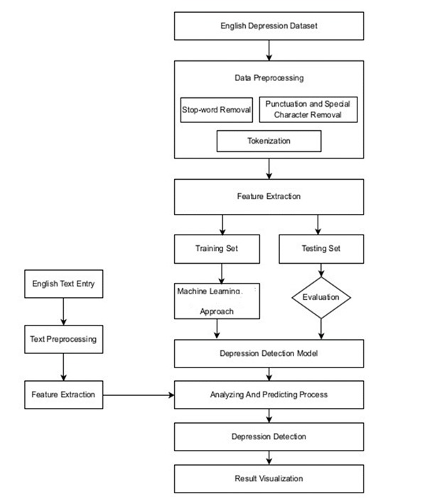
MODEL TESTING AND EVALUATION

Slide 8
ALGORITHMS
Logistic Regression:
Fundamental statistical technique for binary classification tasks.
Predicts probabilities for binary outcomes using the logistic function.
Widely used in healthcare, finance, marketing, and social sciences.
Limitations include assumptions of linearity and sensitivity to multicollinearity.
Naive Bayes:
Based on Bayes' Theorem for classification tasks.
Efficient and scalable with large datasets.
Particularly suited for natural language processing (NLP) tasks like sentiment analysis.
Flexible and reliable technique for probabilistic classification.
Support Vector Machines (SVM):
Robust algorithms for classification and regression tasks.
Effective for categorical problems without assumptions about data distribution.
Finds optimal hyperplane to distinctly classify data points, maximizing margin between classes.

Slide 9
MODEL TESTING AND EVALUATION
Evaluate the trained model's performance on the validation set to assess its generalization ability. Compute evaluation metrics such as accuracy, precision, recall, F1-score, and confusion matrix.

Slide 10
CONCLUSION
The project focuses on Natural Language Processing (NLP) techniques to predict psychological health, aiming to improve healthcare services.
Emphasizes the importance of addressing the rising prevalence of mental health issues globally.
Highlights the need for effective diagnostic tools and intervention strategies, utilizing advancements in ML and NLP for real-time psychological analysis.

Slide 11
FUTURE ENHANCEMENT
Diverse and Extensive Dataset:
Collect data from various sources beyond social media, such as electronic health records, online forums, and mental health surveys.
Incorporate data from multiple languages and cultural contexts to create more generalizable models applicable to a global population.
Expanding Psychological Conditions:
Include a broader range of psychological conditions beyond anxiety disorders, such as depression, bipolar disorder, schizophrenia, and PTSD.
Understand linguistic and emotional markers of these conditions to enhance diagnosis and prediction.
Longitudinal Data Analysis:
Incorporate longitudinal data to understand how psychological states change over time and identify early signs of mental health issues.
Integration into Clinical Practice:
Collaborate with healthcare providers to integrate AI and NLP tools into clinical practice for real-time analysis of patient communication and decision support.
Personalized Treatment Recommendations:
Develop algorithms that recommend personalized treatment plans based on individual patient data, including medical history and treatment responses.
Real-Time Monitoring:
Develop systems for real-time monitoring of psychological health through continuous data collection and analysis via mobile applications and wearable devices.

Slide 12
Thank You

